Slide 1
3D Visualization and Object Detection
114181026 Suhyun Chun

Slide 2
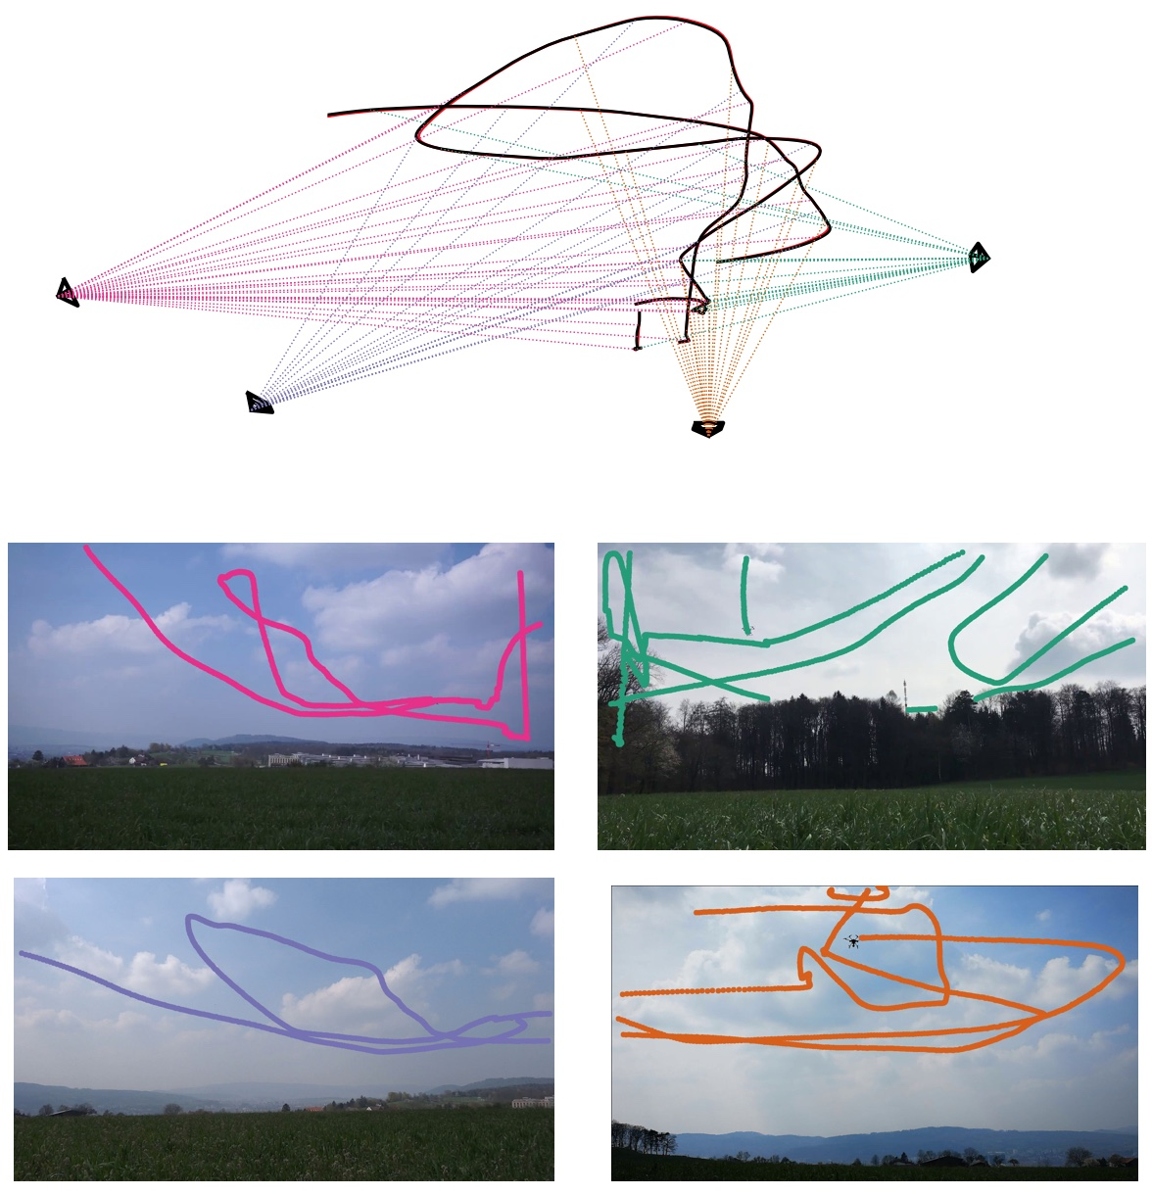
Drone Trajectory 3D Visualization
https://github.com/CenekAlbl/mvus#2d-detection-tracks

Slide 3
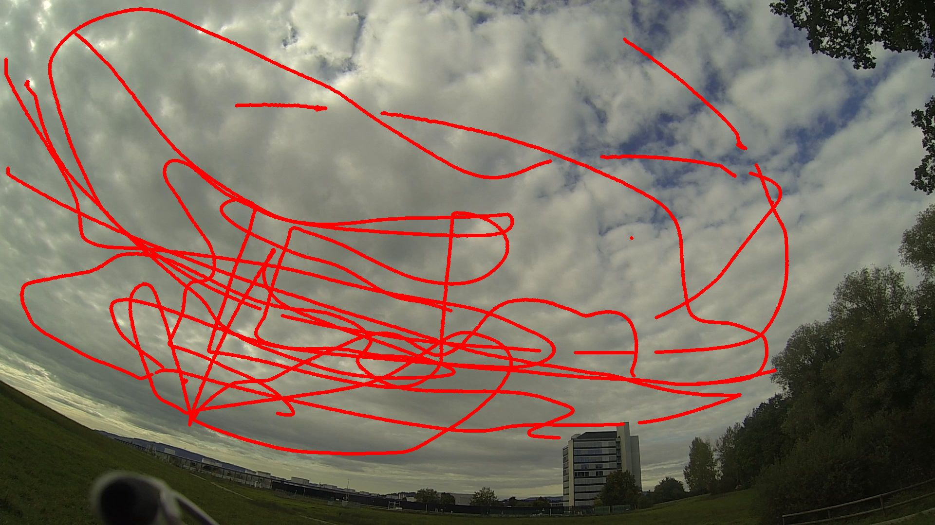
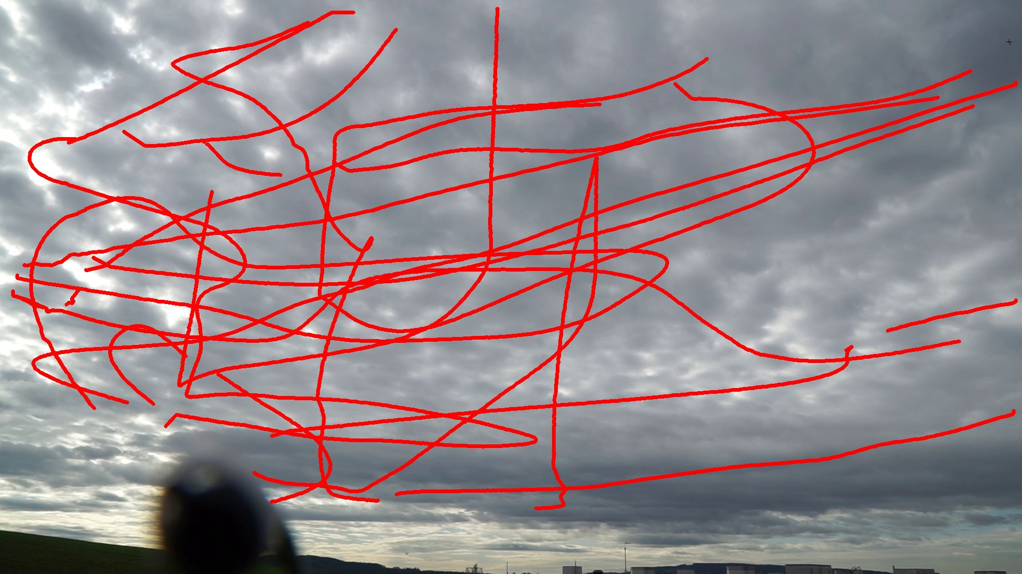
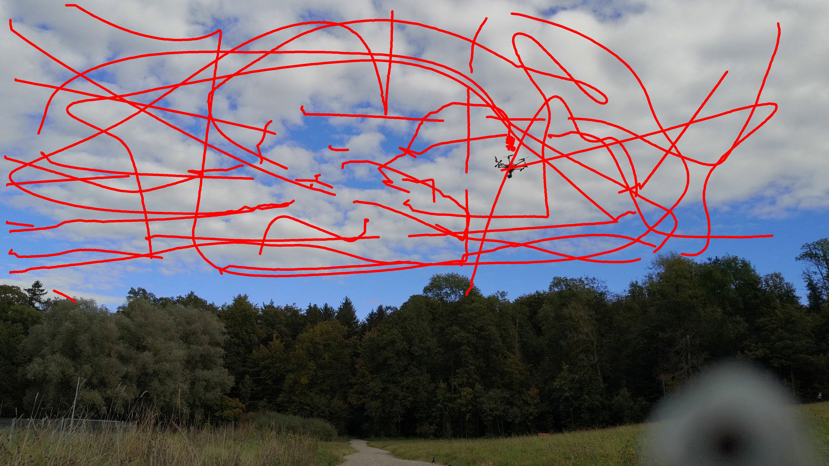
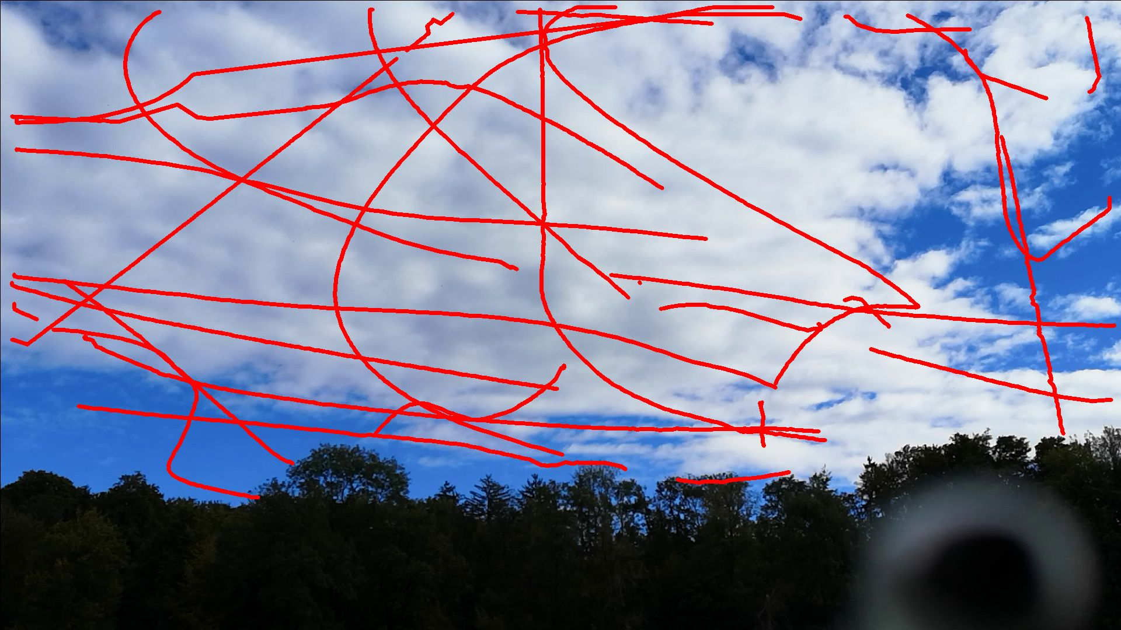
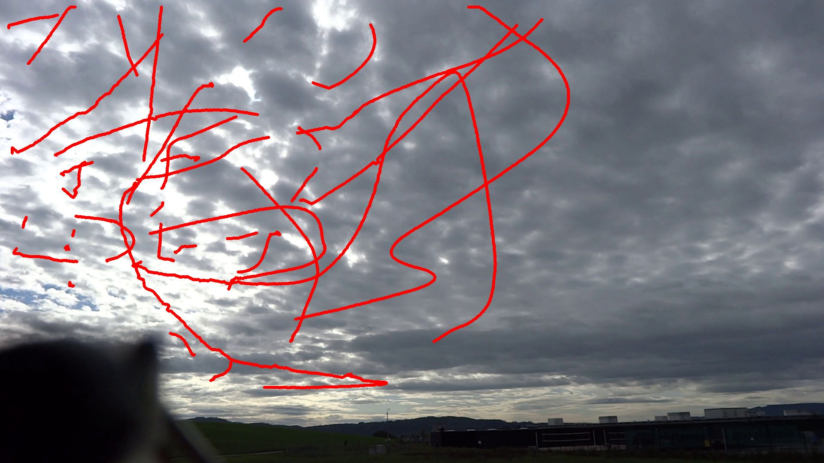
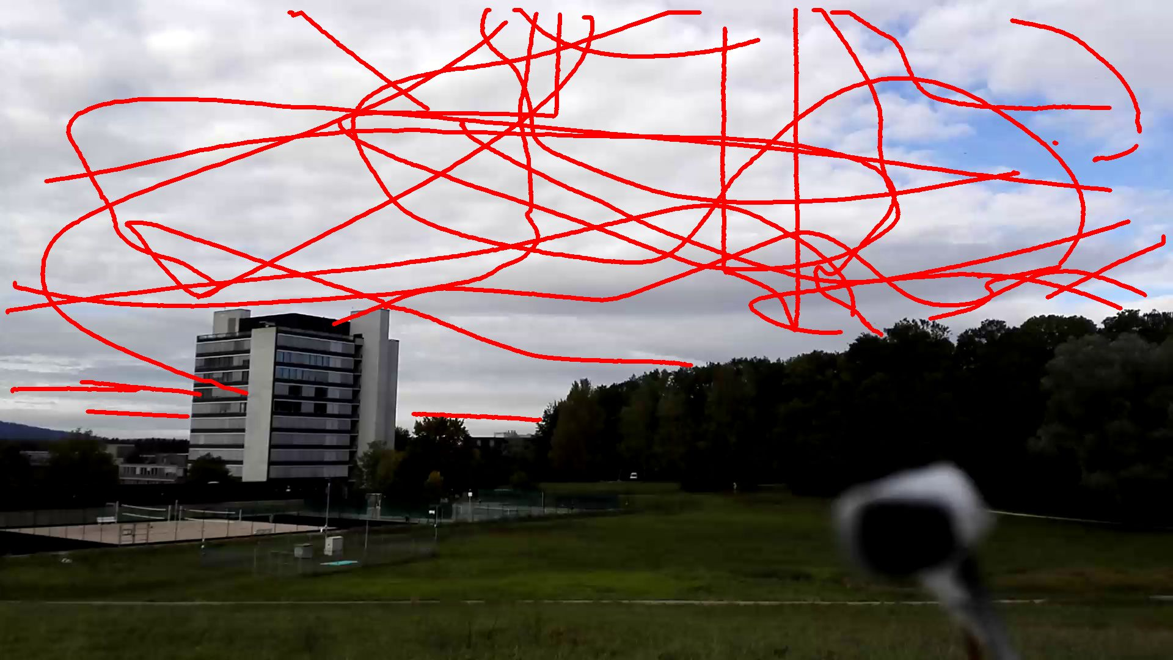
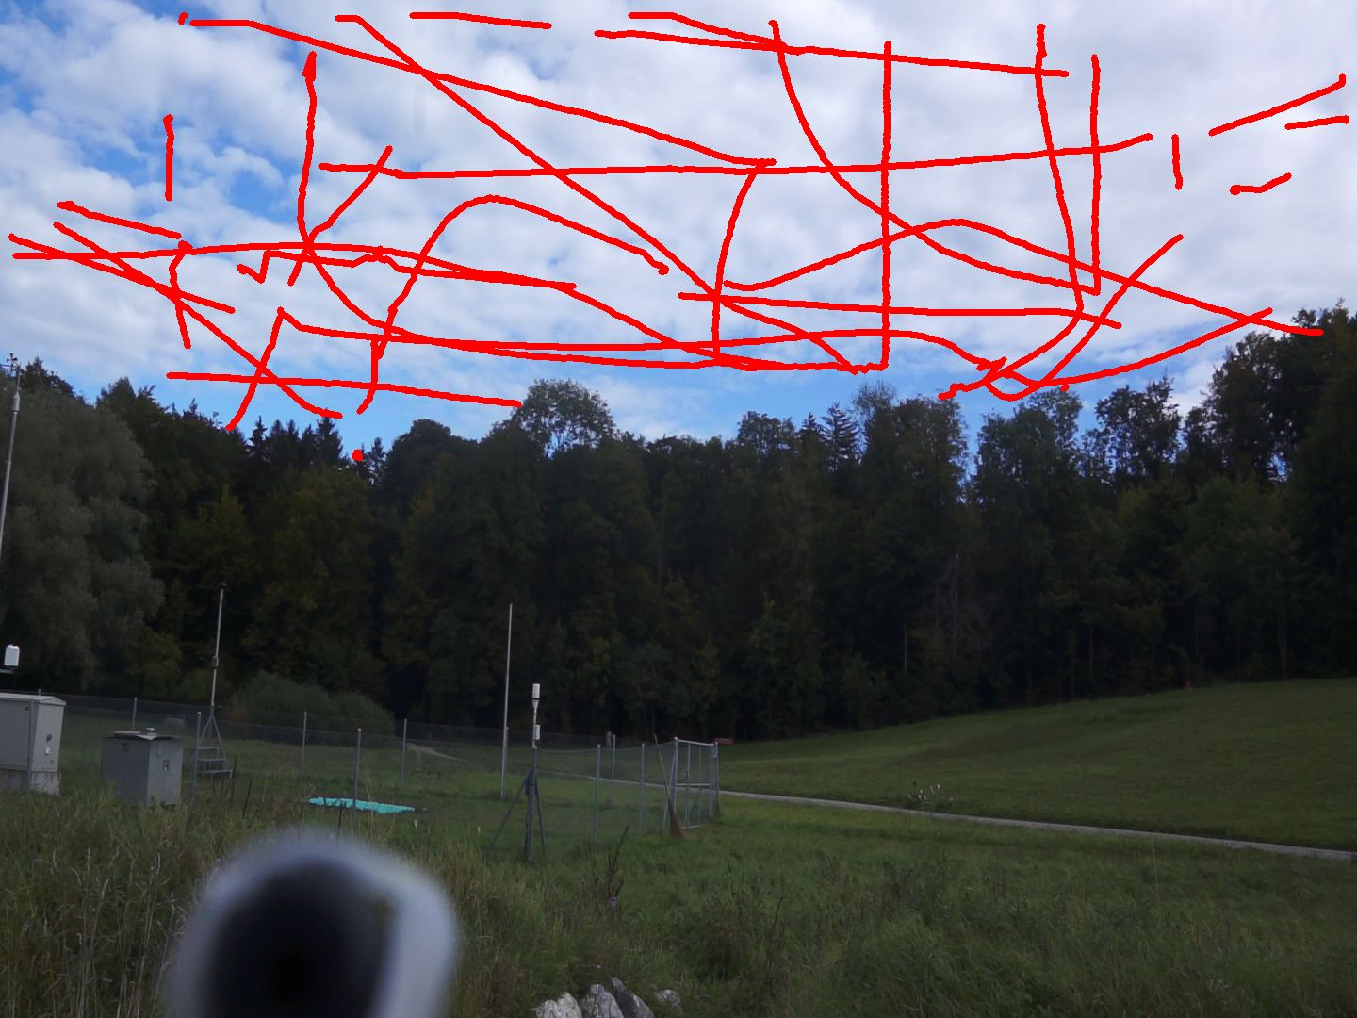
Drone Trajectory 3D Visualization
Notes:
https://github.com/CenekAlbl/mvus#2d-detection-tracks

Slide 4
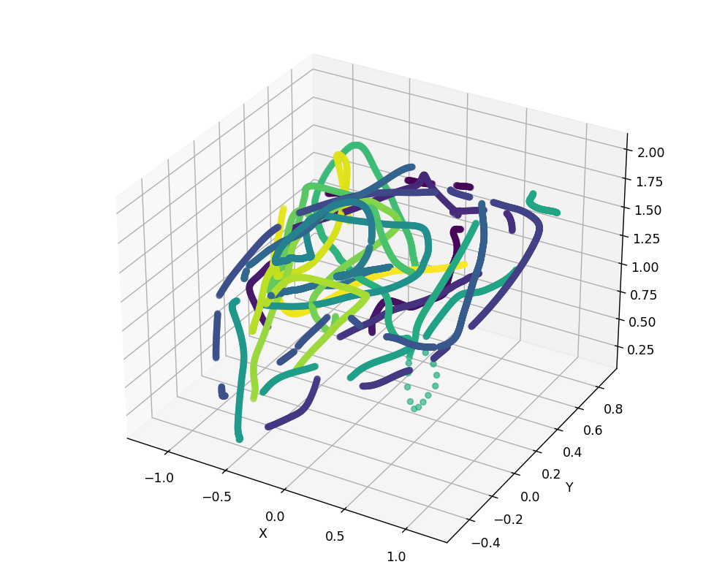
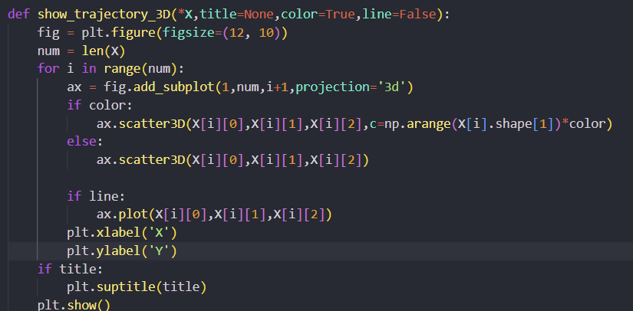
Drone Trajectory 3D Visualization

Slide 5
KML File
Keyhole Markup Language
Use to display geographic data in Google Earth
KML Format for this project →
<LineString id="2">
<extrude>1</extrude>
<altitudeMode>relativeToGround</altitudeMode>
<coordinates>
59.99869103624436,60.00096630379563,16.00927200777572 …
</coordinates>
</LineString>

Slide 6
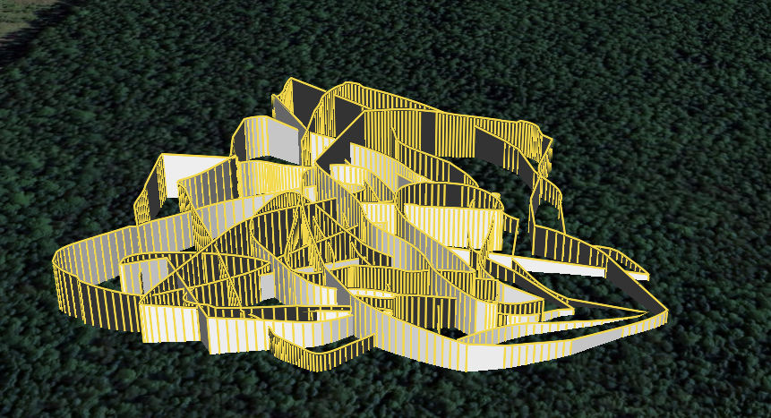
3D Visualization – Google Earth

Slide 7
Problem– Disconnection between Points

Slide 8
Kalman Filter
Algorithm that uses a series of measurements observed over time by estimating a joint probability distribution over the variables for each timeframe
Based on observed data, able to predict the trajectory when it is not able to track the object.

Slide 9
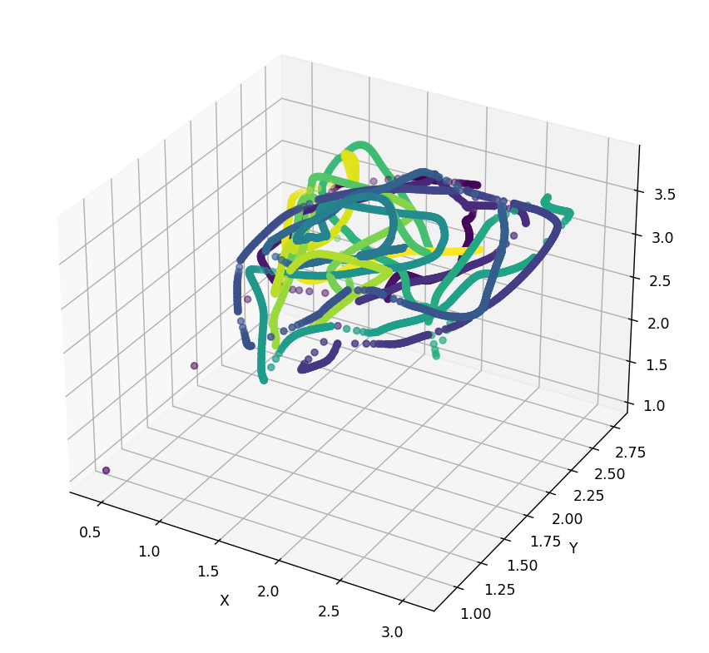
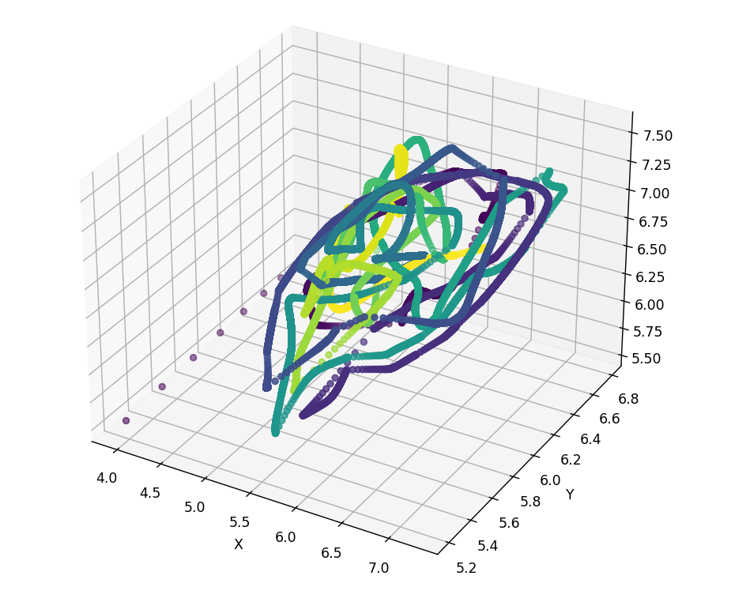
3D Visualization With Kalman Filter
Q = np.array([[0.05,0,0],
[0,0.05,0],
[0,0,0.05]])
Q = np.array([[0.01,0,0],
[0,0.01,0],
[0,0,0.01]])

Slide 10

Object Detection
yolov5
└─data
| └─drone
| ├─test
| │ ├─images
| │ └─labels
| ├─train
| │ ├─images
| │ └─labels
| └─valid
| ├─images
| └─labels
└─drone.yaml
yolov5

Slide 11
Case 1
Training Images: 1000
Epochs : 10

Slide 12
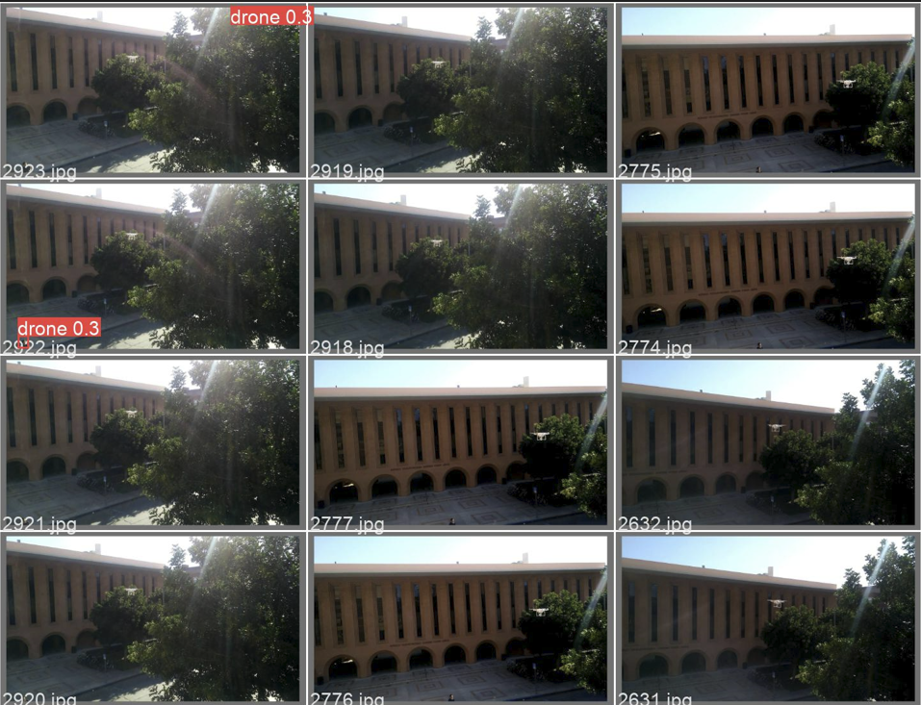

Slide 13
Cannot detect the target object

Slide 14
Case 2
Training Images: 6331
Epochs : 10

Slide 15
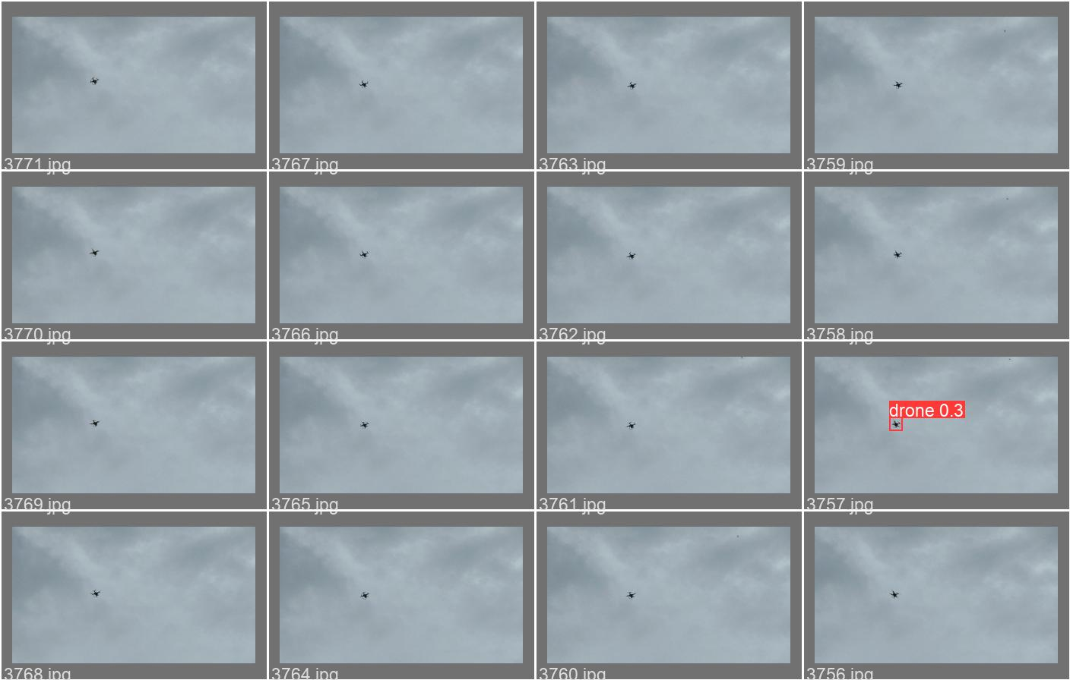

Slide 16
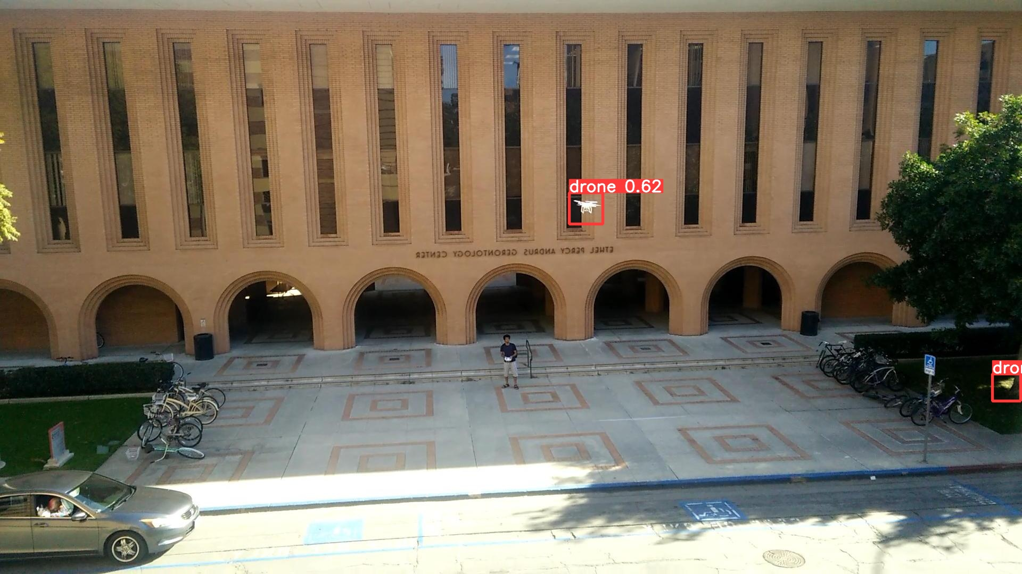
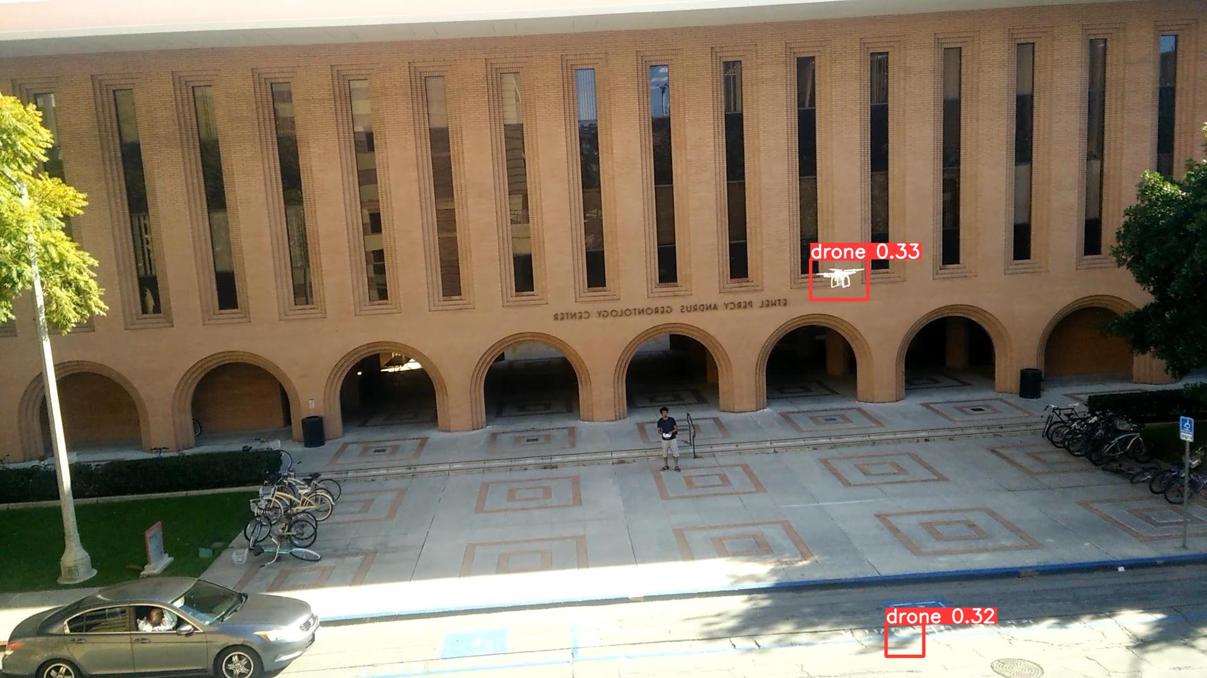

Slide 17
Case 3
Training Images: 6331
Epochs : 100

Slide 18
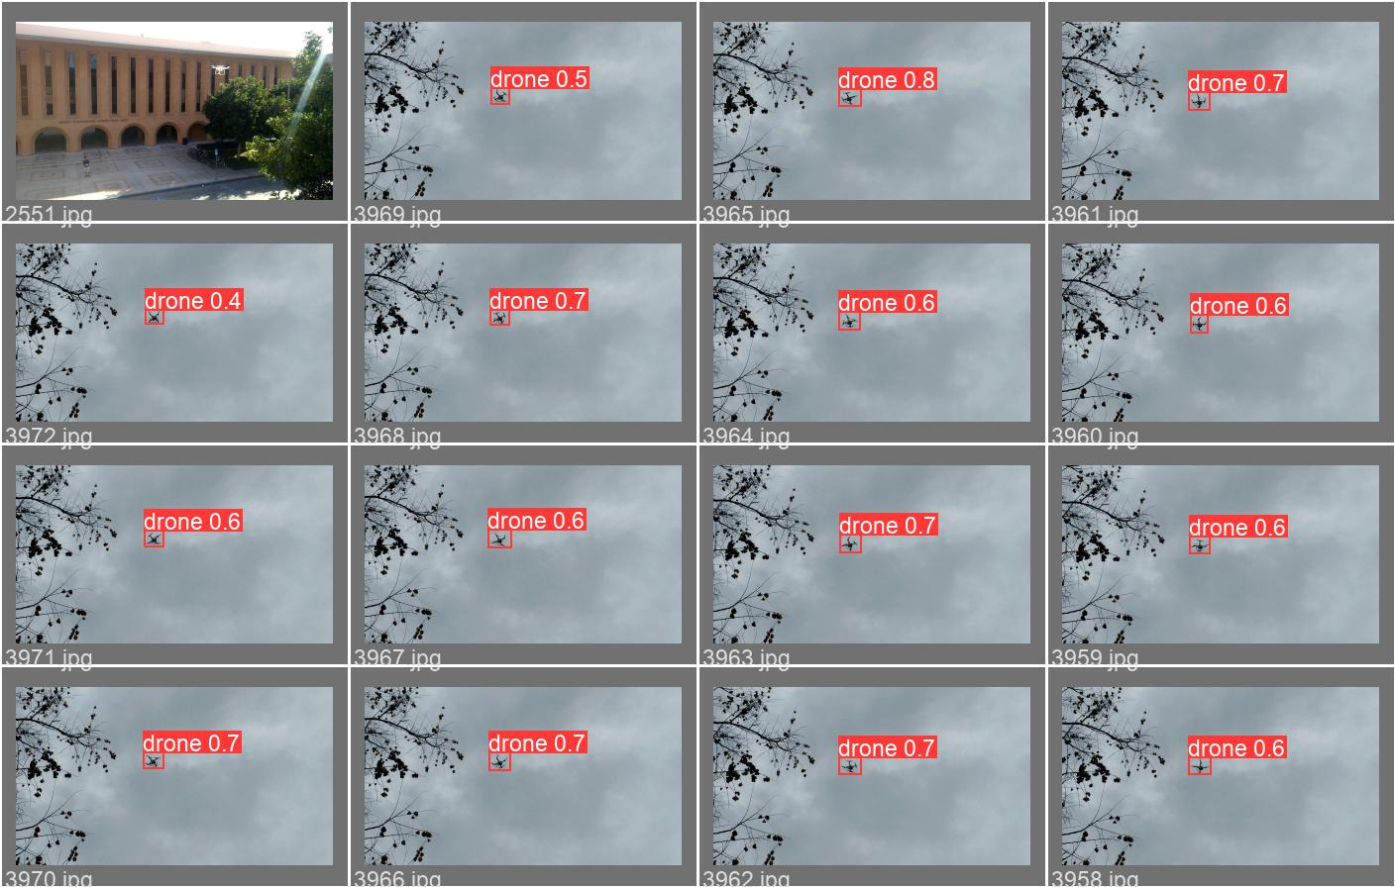

Slide 19
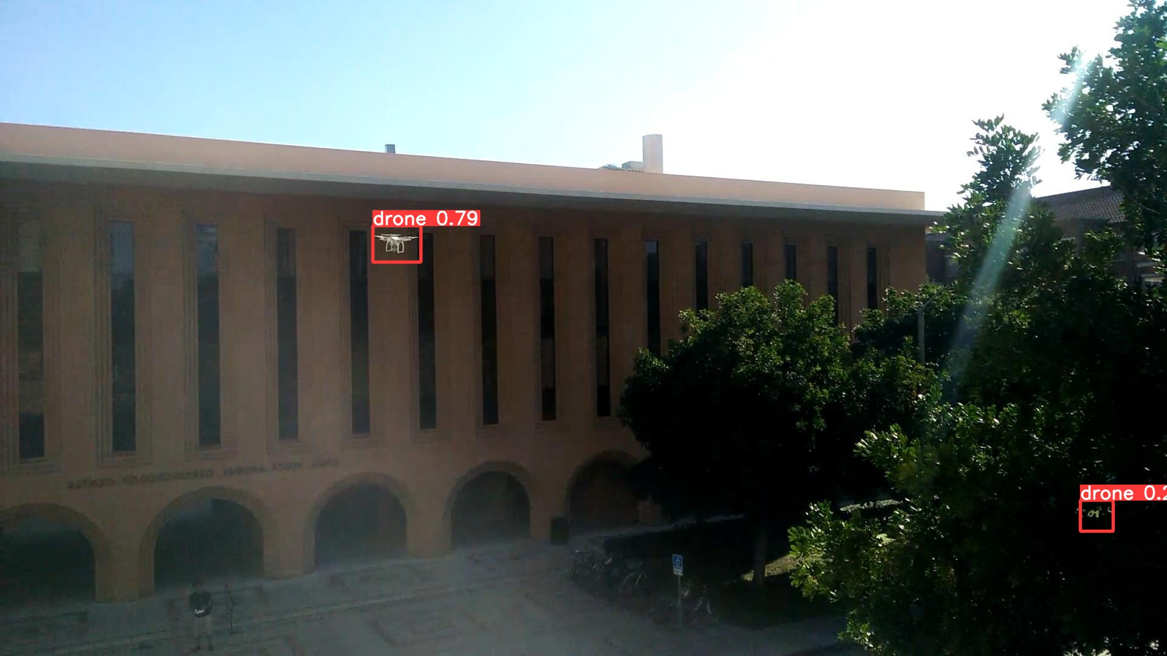
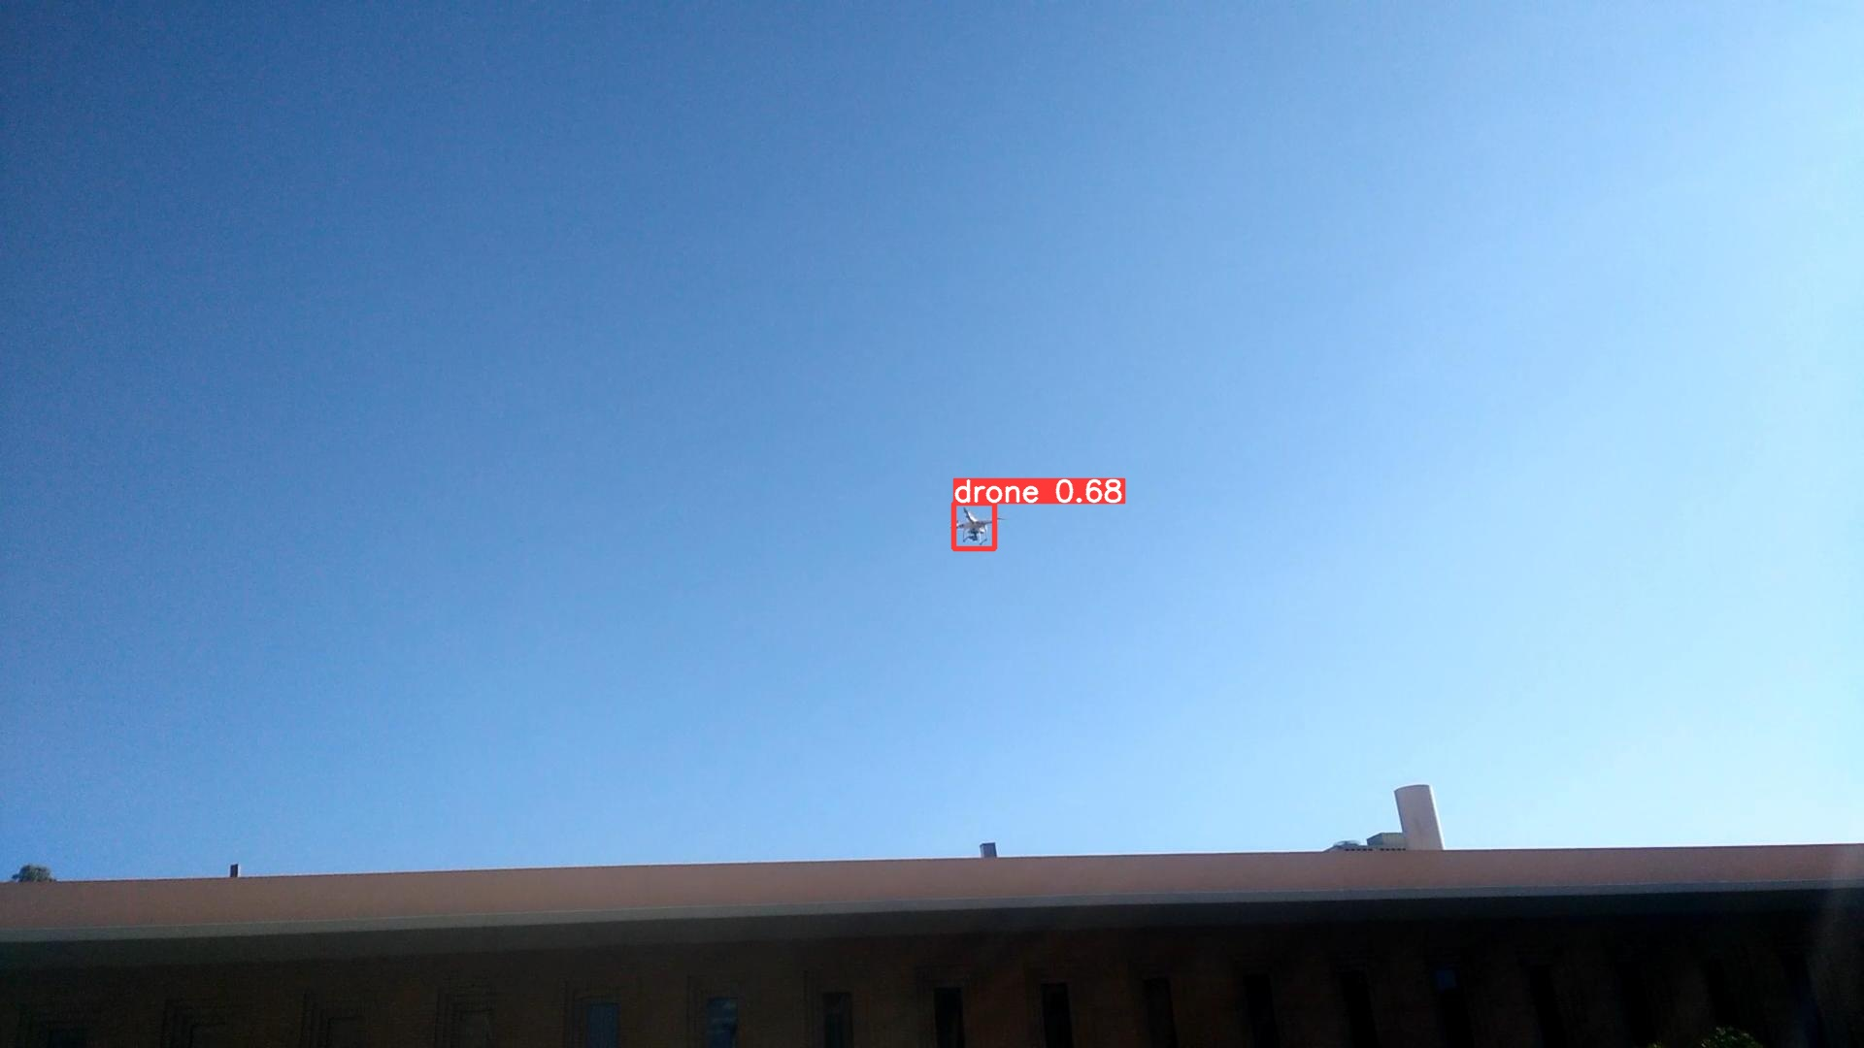

Slide 20
Thank you
Reference :
https://developers.google.com/kml/documentation/kml_tut
https://github.com/CenekAlbl/mvus#2d-detection-tracks
https://en.wikipedia.org/wiki/Kalman_filter

